Slide 1
Database Management Final Project
Aras Corporation
Kellye Houdagba
Modupe Ajala

Slide 2

Business Background
Aras Corporation
PLM Software Company
Headquartered in Andover, MA
Japan
UK
France
Germany
Italy
About 500 employees
Serving Companies like:
GE Aviation
General Motors
BAE Systems
Microsoft
Honda
Competitors
Siemens
PTC
Dassault Systems
Oracle

Slide 3
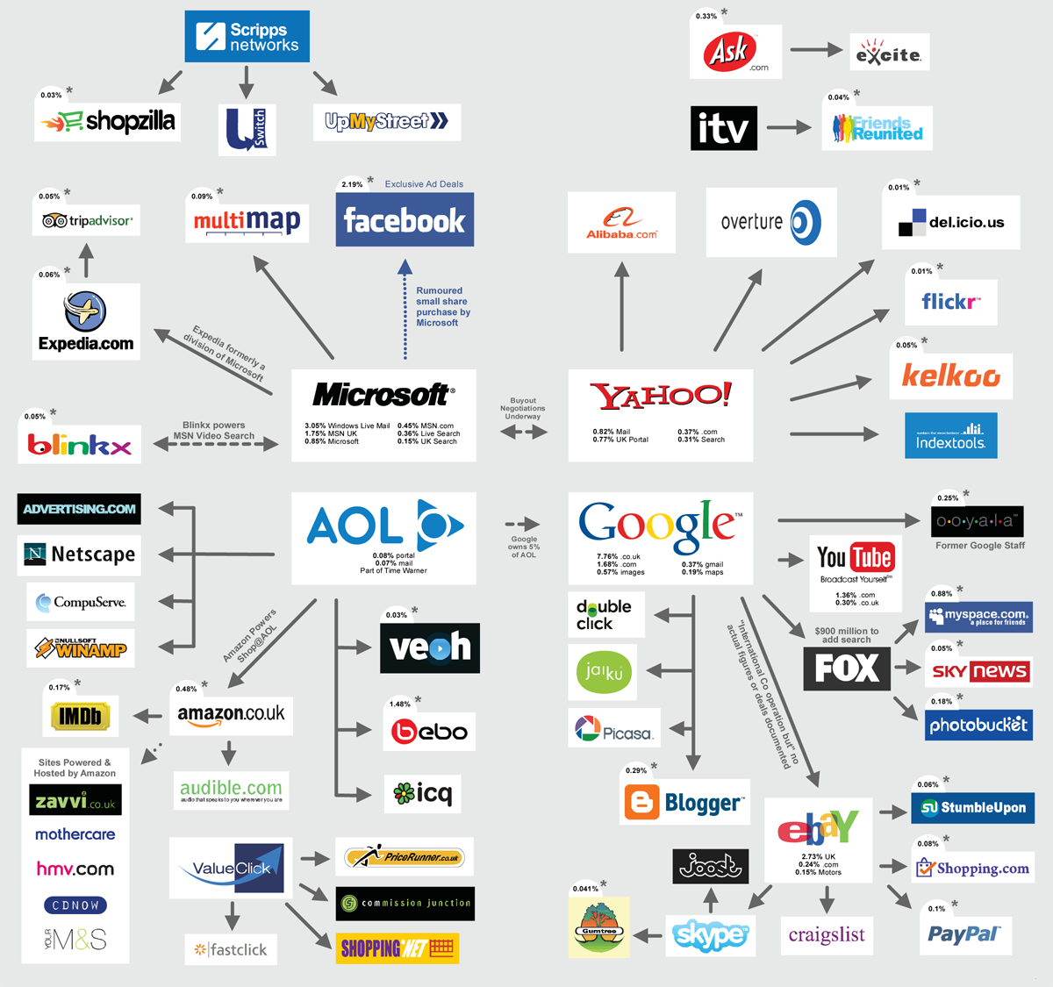
Database Purpose
Current Situation:
Use our own software as a database and tailor it to our needs
Dealing with large Corporations with many companies within them
Need to be able to keep track of which companies fall under which if they do
And keep track of details within these accounts
Problem:
Be able to roll up accounts under enterprise accounts and maintain the contacts, sales reps, opportunities, and more for each account

Slide 4
Business Rules
Every account is either a stand alone account or an enterprise account
An enterprise account can have none or many stand alone accounts
An account can have none or many contacts and each contact is only associated with one account
A sales rep may or may not have an opportunity, however they could have many opportunities.
An opportunity must be associated with one and only one sales rep
A sales rep can manage none or many accounts, an account can be managed by none or only one sales rep
For every account there can only be one opportunity

Slide 5
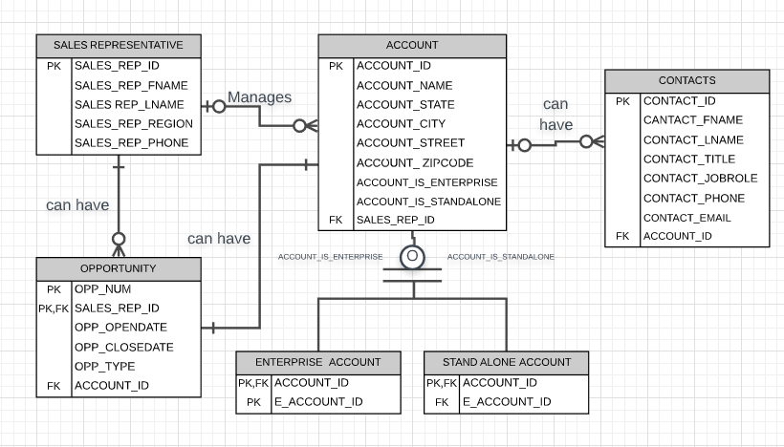
ER Diagram

Slide 6
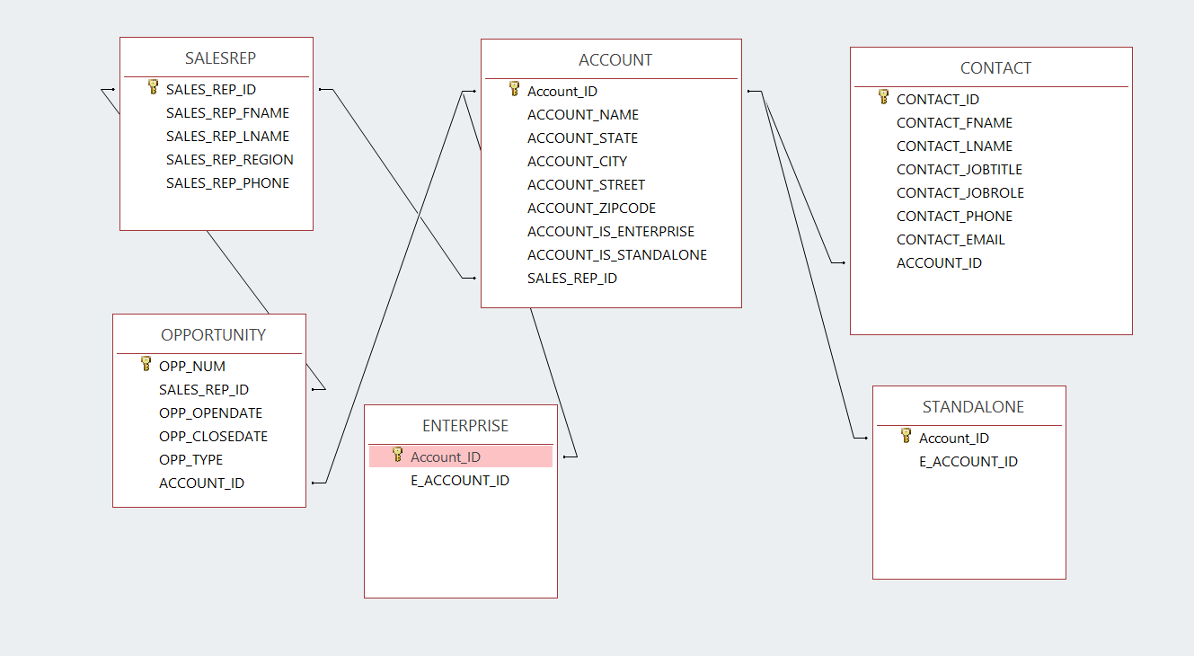
Relational Schema

Slide 7
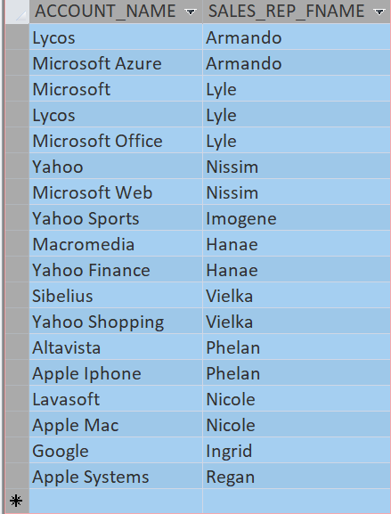
Queries & Results
Display every account name and the sales rep belonging to the account.
SQL Code:
SELECT ACCOUNT.ACCOUNT_NAME, SALESREP.SALES_REP_FNAME
FROM SALESREP INNER JOIN ACCOUNT ON SALESREP.SALES_REP_ID = ACCOUNT.SALES_REP_ID;
Display every account name and the sales rep belonging to the account.
SQL Code:
SELECT ACCOUNT.ACCOUNT_NAME, SALESREP.SALES_REP_FNAME
FROM SALESREP INNER JOIN ACCOUNT ON SALESREP.SALES_REP_ID = ACCOUNT.SALES_REP_ID;

Slide 8
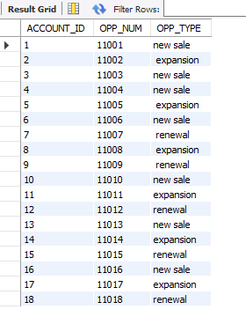
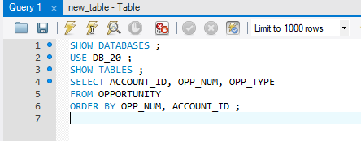
Queries & Results
Display every account name and the sales rep belonging to the account.
SQL Code:
SELECT ACCOUNT.ACCOUNT_NAME, SALESREP.SALES_REP_FNAME
FROM SALESREP INNER JOIN ACCOUNT ON SALESREP.SALES_REP_ID = ACCOUNT.SALES_REP_ID;
Display account id, opportunity number, and opportunity type. Sort by opportunity number then by account id in ascending order.
SQL Code:

Slide 9
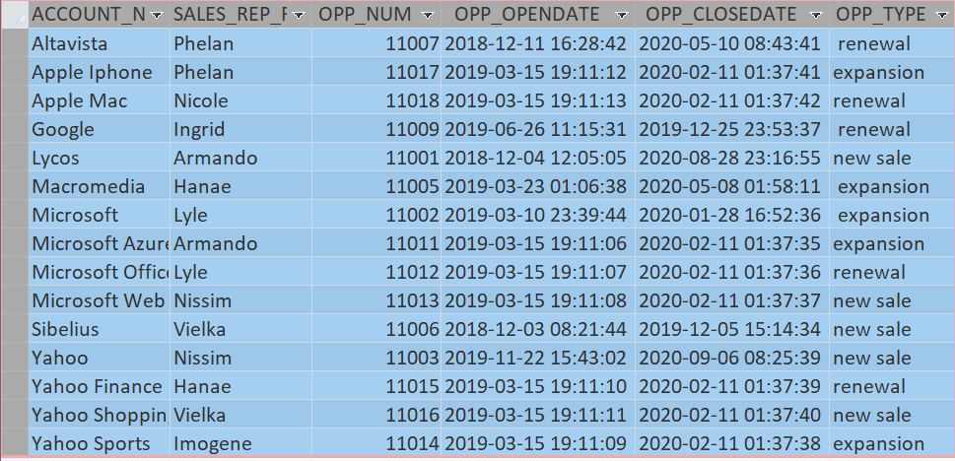
Queries & Results
Display every account name, the sales rep first name belonging to the account, the opportunity number, opportunity open and close date, as well as the opportunity type. Sort by account name in ascending order.
SQL Code:
SELECT ACCOUNT.ACCOUNT_NAME, SALESREP.SALES_REP_FNAME, OPPORTUNITY.OPP_NUM, OPPORTUNITY.OPP_OPENDATE, OPPORTUNITY.OPP_CLOSEDATE, OPPORTUNITY.OPP_TYPE
FROM (SALESREP INNER JOIN ACCOUNT ON SALESREP.SALES_REP_ID = ACCOUNT.SALES_REP_ID) INNER JOIN OPPORTUNITY ON (SALESREP.SALES_REP_ID = OPPORTUNITY.SALES_REP_ID) AND (ACCOUNT.Account_ID = OPPORTUNITY.ACCOUNT_ID)
ORDER BY ACCOUNT.ACCOUNT_NAME;

Slide 10
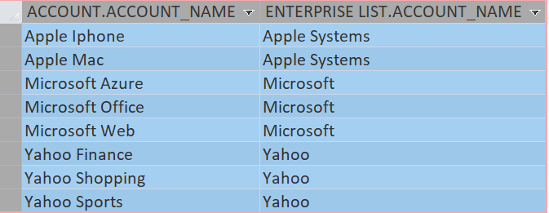
Queries & Results
Display all of the stand alone account names under an enterprise account and the enterprise account name. Order by standalone account name in ascending order.
SQL Code:
SELECT ACCOUNT.ACCOUNT_NAME, [ENTERPRISE LIST].ACCOUNT_NAME
FROM [ENTERPRISE LIST], STANDALONE INNER JOIN ACCOUNT ON STANDALONE.Account_ID = ACCOUNT.Account_ID
WHERE (((STANDALONE.E_ACCOUNT_ID)=[ENTERPRISE LIST].[E_ACCOUNT_ID]))
ORDER BY ACCOUNT.ACCOUNT_NAME;
Display all of the stand alone account names under an enterprise account and the enterprise account name. Order by standalone account name in ascending order.
SQL Code:
SELECT ACCOUNT.ACCOUNT_NAME, [ENTERPRISE LIST].ACCOUNT_NAME
FROM [ENTERPRISE LIST], STANDALONE INNER JOIN ACCOUNT ON STANDALONE.Account_ID = ACCOUNT.Account_ID
WHERE (((STANDALONE.E_ACCOUNT_ID)=[ENTERPRISE LIST].[E_ACCOUNT_ID]))
ORDER BY ACCOUNT.ACCOUNT_NAME;

Slide 11

Learning Lessons + Summary
In reality there’s so much more information that needs to be maintained
There are many ways to do accomplish one goal
We were able to show “roll up” of accounts
Along with contacts, sales reps, and opportunities
Aras in the future:
Looking to be able to keep track of license keys for each account and display “roll up”
Implement this into Aras Innovator

Slide 12
Thank you, Questions?

